Slide 1


Hope Foundation’s International Institute of Information Technology (ISquareIT)Department of Information Technology
Collee Logo
Project Based Seminar Presentation
On
“Tomato Plant Leaf Disease Detection using CNN and Data Augmentation”
By
AKHYAR AHMED
ANKIT CHAUHAN
ASHUTOSH CHALMAL
ONKAR RANSUBHE
Guide
“PROF ANAND B.”
Day and Date of Exam : Saturday, 19th June 2021

Slide 2
Project Details
Problem Statement: Plant leaf disease detection using CNN And Data Augmentation.
Project Domain : Deep Learning.
Project Group Members :
BI006, Akhyar Ahmed
BI009, Ankit Chauhan
BI011, Ashutosh Chalmal
BI032, Onkar Ransubhe

Slide 3
Purpose
The purpose of this project is to identify plant disease in an accurate and timely way so that it reduces the loss of the agricultural production and benefits the people in the best possible way.

Slide 4
SCOPE
Availability.
Accuracy.
Proper remedies will be provided.

Slide 5
Objective
The objective is to train the classifier so that it understands how the given input variables are related to the class.

Slide 6
Abstract
According to past studies, 42% of agricultural production is in loss.
To overcome this major issue, this plant leaf disease detection technique can be applied.
Further various classification techniques are applied.

Slide 7
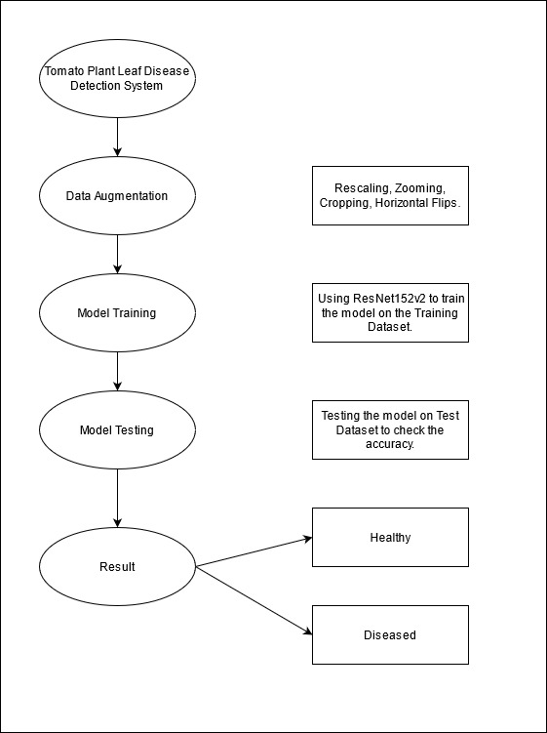
System Architecture

Slide 8
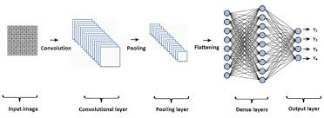
CNN Architecture
CNN Architecture

Slide 9
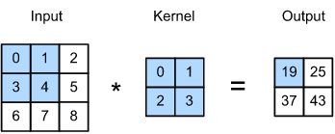
Convolution Operation

Slide 10
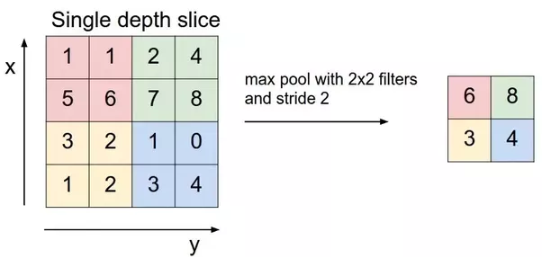
Pooling Operation

Slide 11
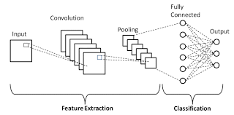
CNN Architecture
CNN Architecture

Slide 12
Phases of our Project
Phase 1 - Literature Survey.
Phase 2 - Collecting the raw datasets.
Phase 3 - Learning about ML/DL techniques through courses.
Phase 4 - Implementing the learned techniques on the collected dataset and finalizing the algorithms according to the accuracies.
Phase 5 - Developing a UI for our project.
Phase 6 - Learning and implementing Flask framework.
Phase 7 - Deploying the model on a cloud platform (Google Cloud Platform).
Phase 8 - Deploying it as an website, so that everyone can use it free of cost.
Phase 9 - Publishing a paper on our project.
Phase 10 - Writing a Report on the Project.

Slide 13
Thank you

